Slide 1

Sentiment Analysis Using Deep Learning
IMSE 514 - Multivariate Statistics
Maya Ravichandran
12/13/2023

Slide 2
Outline
Sentiment Analysis Using Deep Learning
1
Introduction
5
Methodology
2
Modeling Techniques
6
Results
3
Executive Summary
7
Conclusion
4
Exploratory Data Analysis
8
References

Slide 3
Introduction
Sentiment Analysis Using Deep Learning
What is sentiment analysis?
A way to evaluate a text in order to get information about the expression (positive, negative, or neutral)
It uses a mix of statistics, natural language processing, and machine learning.
Types of Sentiment Analysis
01
02
Subjectivity Classification
Polarity Classification
Classifies a sentence as opinionated or not opinionated
Classifies opinionated sentences as positive or negative
03
04
Aspect Based Sentiment Analysis
Fine Grained Sentiment Analysis
Defines both the sentiment and its intensity
Detects sentiment towards a specific component of a product/service

Slide 4
Introduction
Sentiment Analysis Using Deep Learning
Brand Monitoring
01
02
Competitive Research
To monitor what people say about an organization, product, or service
To track how society evaluates their competitors
Applications of Sentiment Analysis
Optimize Customer Care
03
04
Product Analysis
Gather early feedback about a product
Analyze customer reviews and fix issues
Market Research
05
06
Human Resources
Track and study consumers behavior to predict future trends
Analyze employees surveys to improve performance

Slide 5

Introduction
Sentiment Analysis Using Deep Learning
Better Service
Data Analysis
Uber
Collects
Complaints
Reviews
Contextual semantic search showed that the most popular topic that people care about is safety.
Multiple safety features were developed to keep the customers protected all the time.
Suggestions

Slide 6
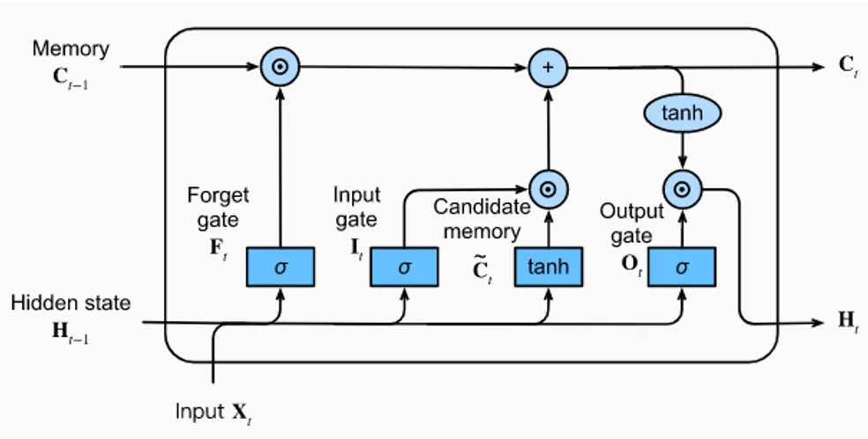
Modeling Techniques
Sentiment Analysis Using Deep Learning
Long Short Term Memory (LSTM)
Type of recurrent neural network (RNN)
Capable of learning long-term dependencies in sequential data
Recurrent Neural Network (RNN)
Bidirectional artificial neural network
Networks with an infinite impulse response
Able to use internal state (memory) to process arbitrary sequences of inputs

Slide 7
Executive Summary
Sentiment Analysis Using Deep Learning
01
Import Python Packages
NLTK, SK-Learn, Tensorflow
02
Load Data
Load tweets into a dataframe from the dataset
The project was conducted with the following steps:
03
Preprocessing
Set labels, define functions, data cleaning, tokenization, prepare training and test datasets
04
Build RNN Model
Define RNN layers and train the model.
05
Testing and Inference
Evaluate the model, test samples, run inference
06
Check the Performance
Confusion Matrix and ROC curve

Slide 8
Exploratory Data Analysis
Sentiment Analysis Using Deep Learning
The dataset contains 1,600,000 tweets extracted using the twitter api.
The tweets have been annotated (0 = negative, 2 = neutral, 4 = positive).
The content contains the following 6 fields:
1 | target: the polarity of the tweet (0 = negative, 2 = neutral, 4 = positive)
2 | ids: The id of the tweet ( 2087)
3 | date: the date of the tweet (Sat May 16 23:58:44 UTC 2009)
4 | flag: The query (lyx). If there is no query, then this value is NO_QUERY.
5 | user: the user that tweeted (robotickilldozr)
6 | text: the text of the tweet (Lyx is cool)

Slide 9
Exploratory Data Analysis
Sentiment Analysis Using Deep Learning
Twitter data was analyzed by the following filtering techniques:
1 | Emotions which had the following symbols were removed/ stripped off: Emoticons mapped to :),:-),: ) ,:D,=) Emoticons mapped to :( , :(, :-(, : (,
2 | Any tweet containing both positive and negative emoticons are removed. This may happen if a tweet contains two subjects.
3 | Retweets are removed. Retweeting usually happens if a user likes another user’s tweet. Retweets are commonly abbreviated with “RT.”
4 | Tweets with “:P” are removed
5 | Repeated tweets are removed

Slide 10

Exploratory Data Analysis
Sentiment Analysis Using Deep Learning
Positive Emotions
Took the first 800,000 tweets
50 %
Test Data
(Manually collected)
177 negative tweets
182 positive tweets
Training Tweets
1,600,000
Negative Emotions
Took the first 800,000 tweets
50 %

Slide 11
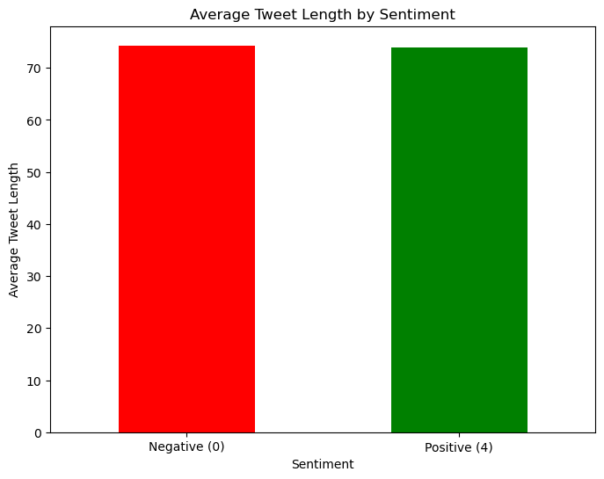
Exploratory Data Analysis
Sentiment Analysis Using Deep Learning
Few exploratory analysis points: The Average Tweet Length by Sentiment

Slide 12
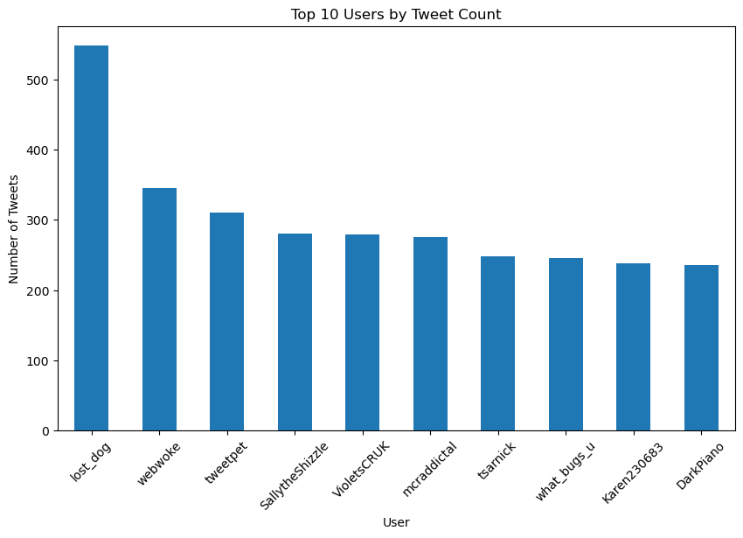
Exploratory Data Analysis
Sentiment Analysis Using Deep Learning
Few exploratory analysis points: The top 10 users by tweet count

Slide 13
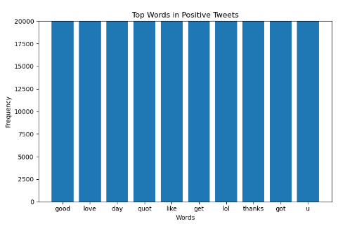
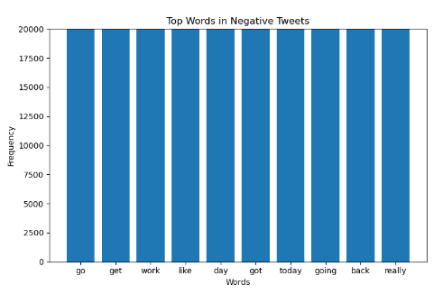
Exploratory Data Analysis
Sentiment Analysis Using Deep Learning
Few exploratory analysis points: The top words in each sentiment

Slide 14

Methodology
Sentiment Analysis Using Deep Learning
05
04
Testing the Model
03
Training the Model
02
Compare predictions of the test data to the labels
Defining the Loss Function
01
Feed the data
Validation data: 15% of the training data
Batch size: 80
Epochs: 5
Building the RNN Model
Use sparse categorical cross entropy
Optimization: Adam
Metrics: Accuracy
Data Cleaning
Layer 1: Embeddings
Layer 2: Spatial Dropout
Layer 3: LSTM
Layer 4: Dense layer
Remove the unwanted features
Tokenize the sentences
Split the data into 70% training and 30% testing

Slide 15
Results
Sentiment Analysis Using Deep Learning
Accuracy
The percentage of correctly predicted tweets from the total
 | Prediction: Negative Sentiment | Prediction: Positive Sentiment
Actual: Negative Sentiment | 4409 | 1600
Actual: Positive Sentiment | 1432 | 4559
74.73 %

Slide 16
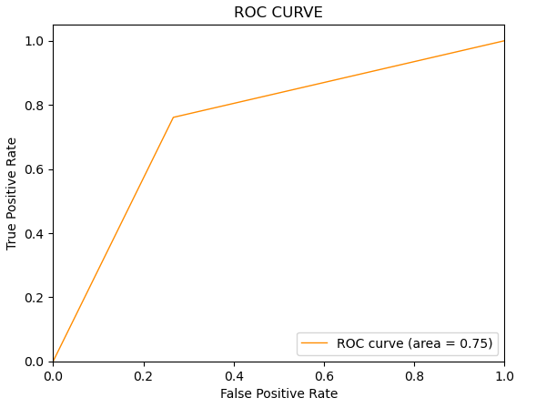
Results
Sentiment Analysis Using Deep Learning
AUC = 0.75
There is a 75% chance that the model will be able to distinguish between the positive tweets and the negative tweets.

Slide 17
Conclusion
Sentiment Analysis Using Deep Learning
Project’s Objective:
Classify tweets sentiments on Twitter as
using
RNN and LSTM
Project’s Steps:
Project’s Results:
Batch size = 80
Epochs = 5
Accuracy
Future Work:
Parameter Tuning
Change the batch size and epochs until we get better results
Prepared the data
Built the model
Positive
Negative
Trained the model
Tested the model
74.73 %

Slide 18
References
Sentiment Analysis Using Deep Learning
https://www.qualtrics.com/experience-management/research/sentiment-analysis/
https://towardsdatascience.com/sentiment-analysis-concept-analysis-and-applications-6c94d6f58c17
https://www.altexsoft.com/blog/sentiment-analysis-types-tools-and-use-cases/
https://d2l.ai/chapter_recurrent-modern/lstm.html

